Slide 3
Landforms of the Earth

Slide 5
THE UPS AND DOWNS OF THE EARTH /Social/N Karunambigai//SNS ACADEMY

Slide 7
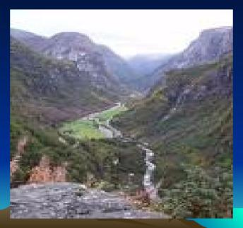
The ups and downs of the Earth/Karunambigai/Social/SNS ACADEMY

Slide 8
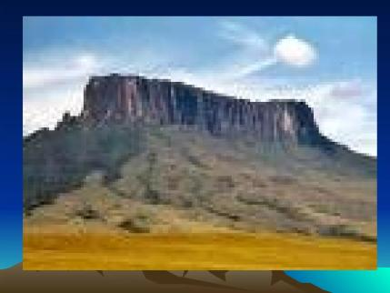

Slide 9
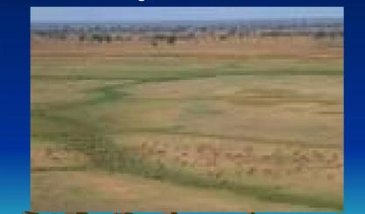

Slide 10
Calendars we use

Slide 12
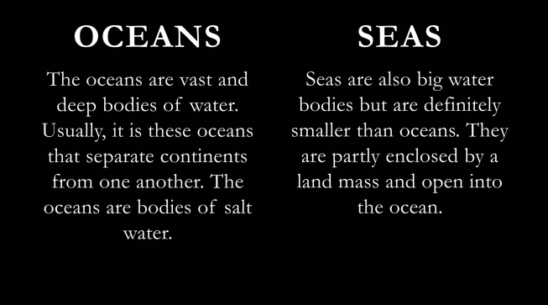
WATER BODIES OF THE EARTH

Slide 16
STREAM

Slide 17
WATERFALLS

Slide 18
LAGOON

Slide 19
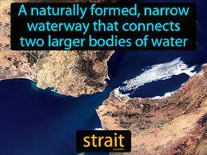
STRAIT

